Slide 1



Five Dreaded Days that Can Ruin Your Whole Vacation
Presented by:
Adam the Automator

Slide 2

About the Author
Pluralsight Author
PowerShell Trainer
Freelance Writer
PowerShell Consultant
Blog: adamtheautomator.com
Twitter: @adbertram
Microsoft Cloud/ Datacenter Management MVP

Slide 3

The "Single" in Single Sign-On
The Good
Easy to manage
Applications integrate easily
The Ugly
One basket; LOTS of eggs
Don't drop the basket

Slide 4
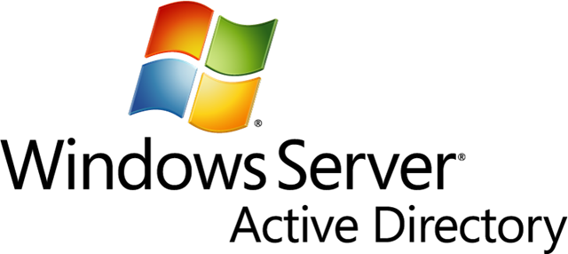



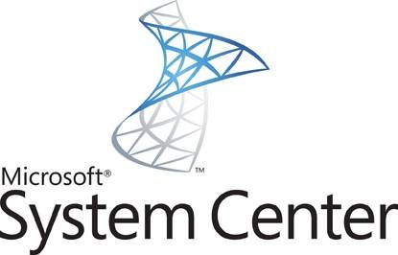
Active Directory Dependencies
ACLs

Slide 5









Replication Can be Your Friend or Worst Enemy
@adbertram

Slide 6


AD Backup Woes
"Doing a test restore is hard!"
"I'm sure backups are fine.“
"I assume it'll restore correctly when we need it.“
Notes:
Mention the Virtual Recovery Lab environment here

Slide 7
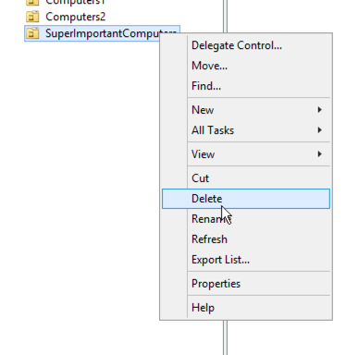
Easy to Break; Hard to Fix
The right-click/delete of doom
Scripts gone awry
Oops! Wrong RDP window!
$variable1 = 'john' $variable2 = 'superimportantcomputers' Remove-ADObject $variable2

Slide 8

Types of Disasters
Human oopsies
Natural disasters
Technical
Hardware failure
Software corruption
Malicious employees
Cyber attacks

Slide 9
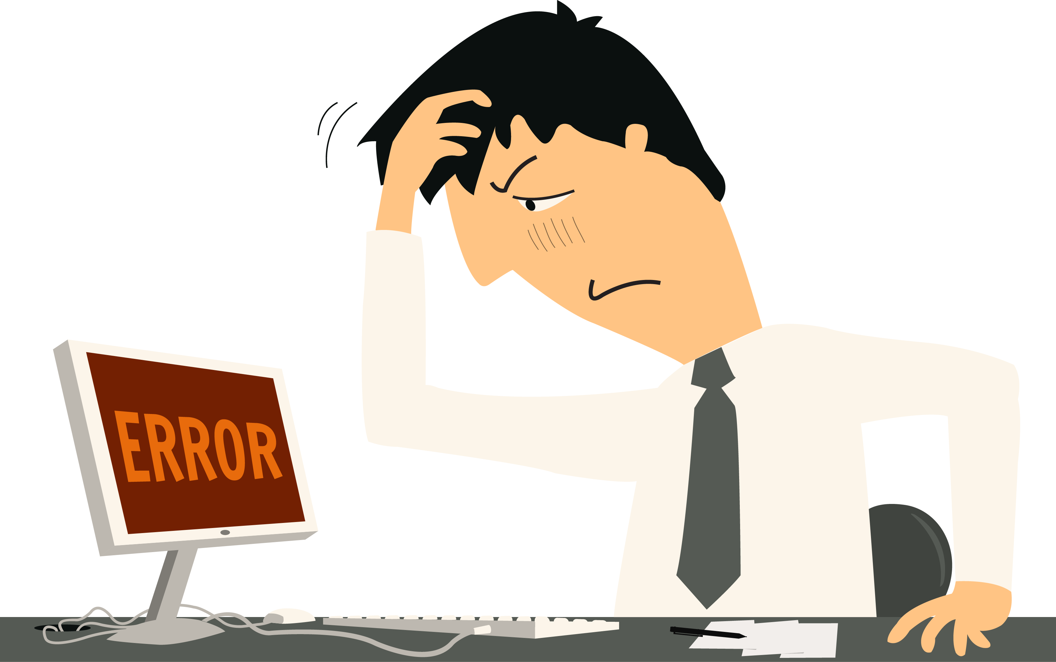
The Missing User
User account gets deleted
The user SID is important
Desktop settings
Defined ACLs
Use the AD recycle bin

Slide 10


A Really Big Basket: Azure AD
AD in the cloud
Outside dependencies
Still prone to human mistakes
Potential to extend corruption
Learning new tech

Slide 11
The Day I Deleted my Department
function Remove-StaleAdUsers { param( $AgeInDays ) $parameters = @{
‘Server’ = ‘mylab.local’
‘Filter’ = ‘*’
‘Properties’ = ‘LastLogonDate’
}
$staleUsers = Get-ADUser @parameters | where {$_.LastLogonDate -lt (Get-Date).AddDays(-$AgeInDays)}
$staleUsers | Remove-ADUser -Confirm:$false } Remove-StaleAdUsers -AgeInDays 0

Slide 12
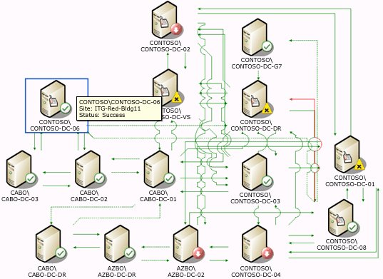
The Dangers of Multitasking
Pay attention to RDP windows!
Don't forget about DNS!

Slide 13

Unexpected AD Dependencies
Know your AD dependencies
Know how to perform forest-level restores

Slide 14

How to Prevent Disasters
Locking down user rights
Ensure "Protect object from accidental deletion" is checked
Change management
Active monitoring
Dell recovery solutions

Slide 15

Built-in Recovery Tools
Scripts
AD Recycle bin
Microsoft documentation
Microsoft support

Slide 16

Takeaways
Backups and testing
Control AD access
Know all AD dependencies
Be prepared!
Have the recovery tools in place before the disaster happens

